Slide 1

Conditional GAN
Ahsan Lohdi, Yang An
Technical University of Munich
Department of Informatics
Computer Vision Group
Garching, 07. May 2019

Slide 2
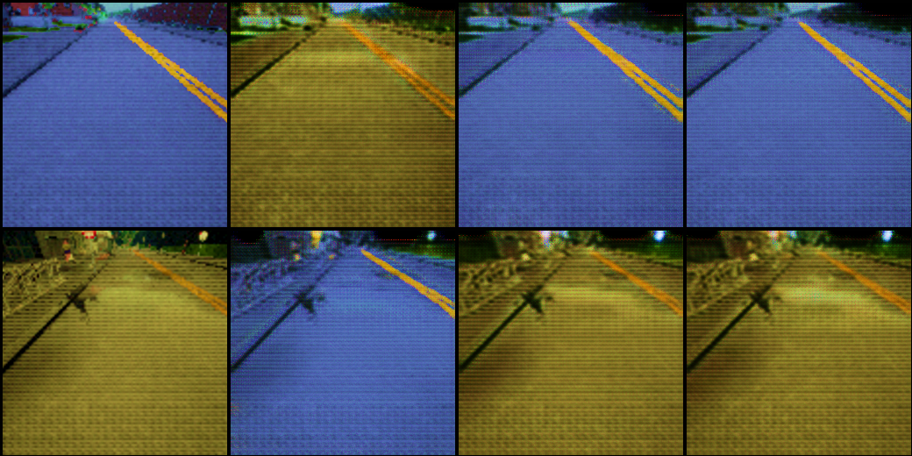
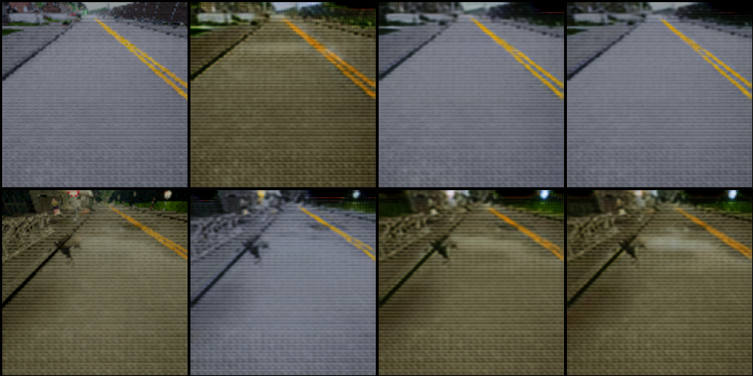
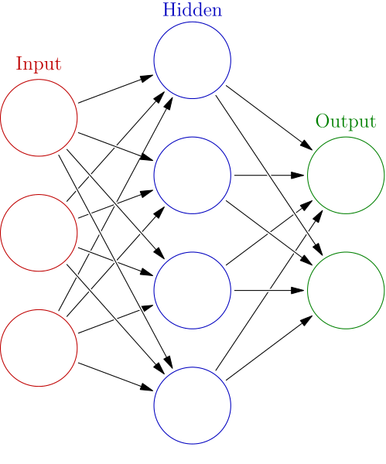

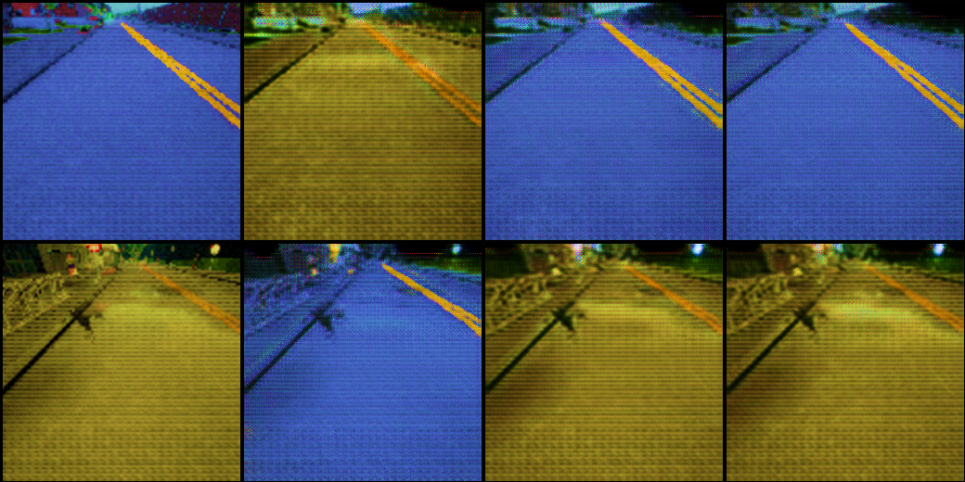
Our Goal
Switch 1 On
Input Image
Switch 2 On
Switch 1
Switch 2
Generator G
Switch 3 On
Switch 3

Slide 3
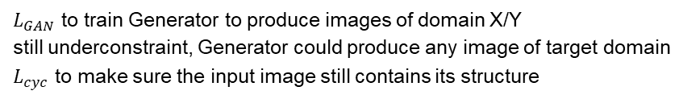
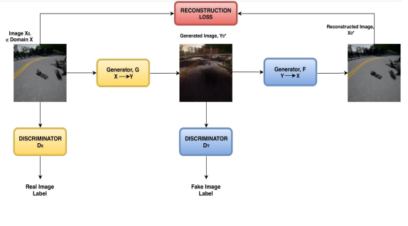
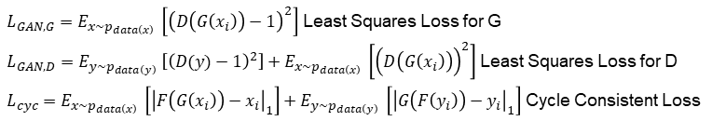
CycleGAN

Slide 4
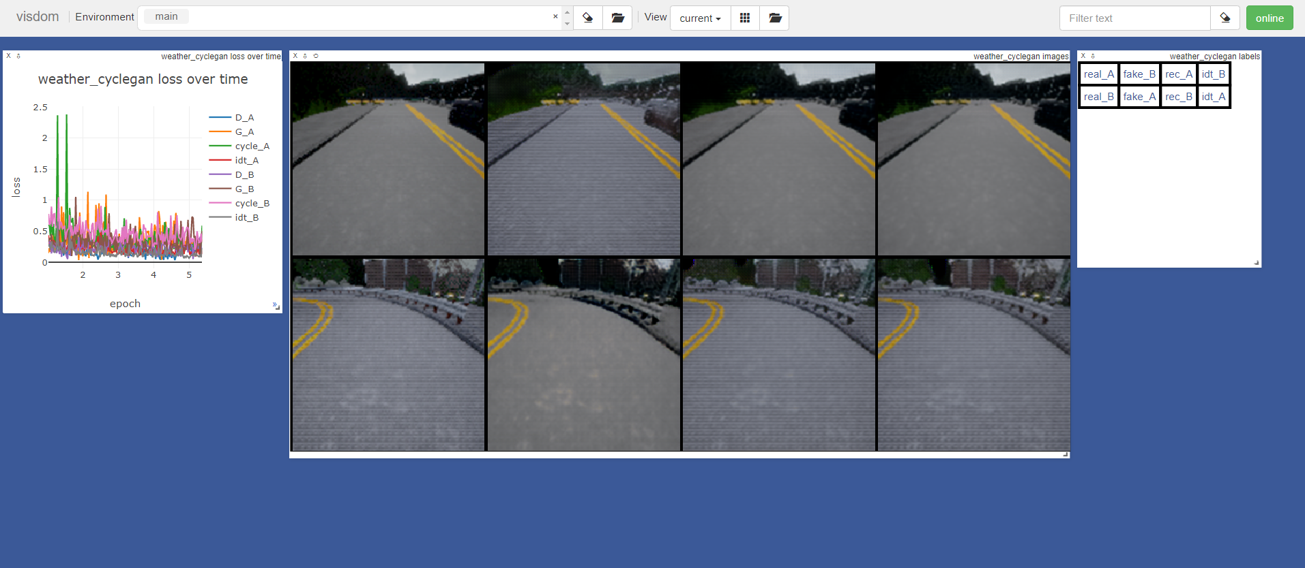
Results from our first test

Slide 5
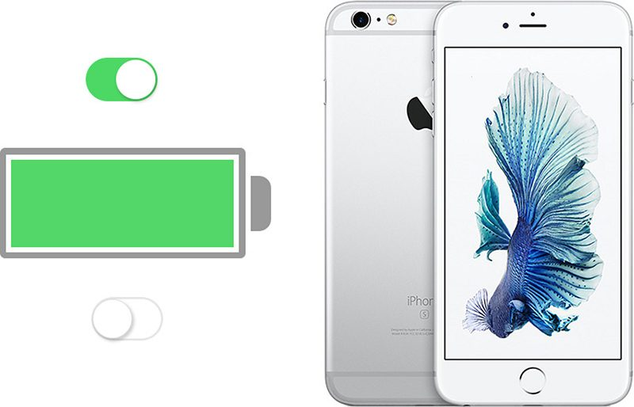
Next Step
Switch?
Generator G
Y🡪X
1 | 1 | 1 | 1
1 | 1 | 1 | 1
1 | 1 | 1 | 1
Same Network with shared weights
Switch on
Switch off
add new channel
with only 1s or 0s

